Slide 1
The Economy of the World Cup

Slide 2
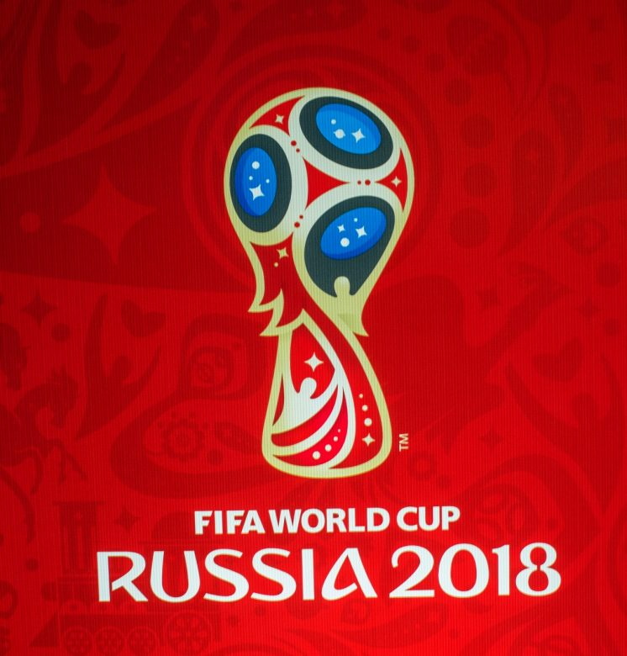
Outline
RE-introduce the project
What were the goals?
About the data
Analysis
What were the findings?
Conclusion and further research
Notes:
Known economic impacts for competing teams and host countries
Lasting impacts of making the World Cup
Goals:
Analyze the factors that equate to positive and negative impacts of hosting the World Cup
Analyze the impact of competing and winning the tournament

Slide 3
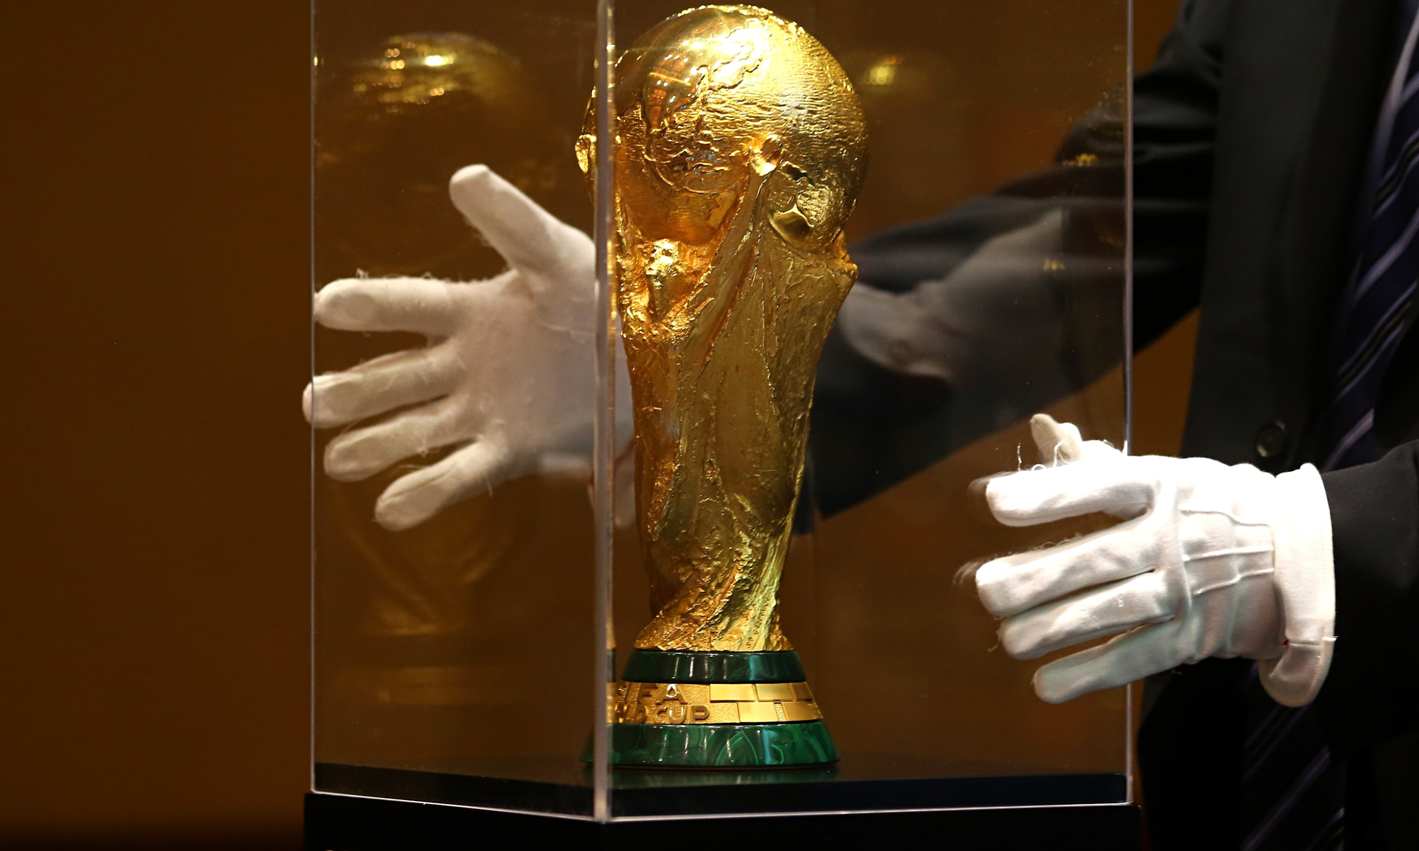
What is the World Cup?
The largest international soccer tournament in the world, sanctioned by the world governing body of soccer, FIFA
First tournament was held in 1930, held every four years
The most widely watched sporting event in the world, surpassing even the Olympics
The 2018 World Cup attracted over 3 billion unique viewers.
The World Cup trophy is valued at $20 million!
Notes:
Started with only 13 teams in 1930, played in a group stage round with single elimination in the next round. Two tourneys cancelled during WWII. Expanded to 24 teams in 1982, with 2 groups. Changed to current format in 1986 - 6 groups of 4, then moving to knockout stage of 16. Grew to 32 in 1998.

Slide 4
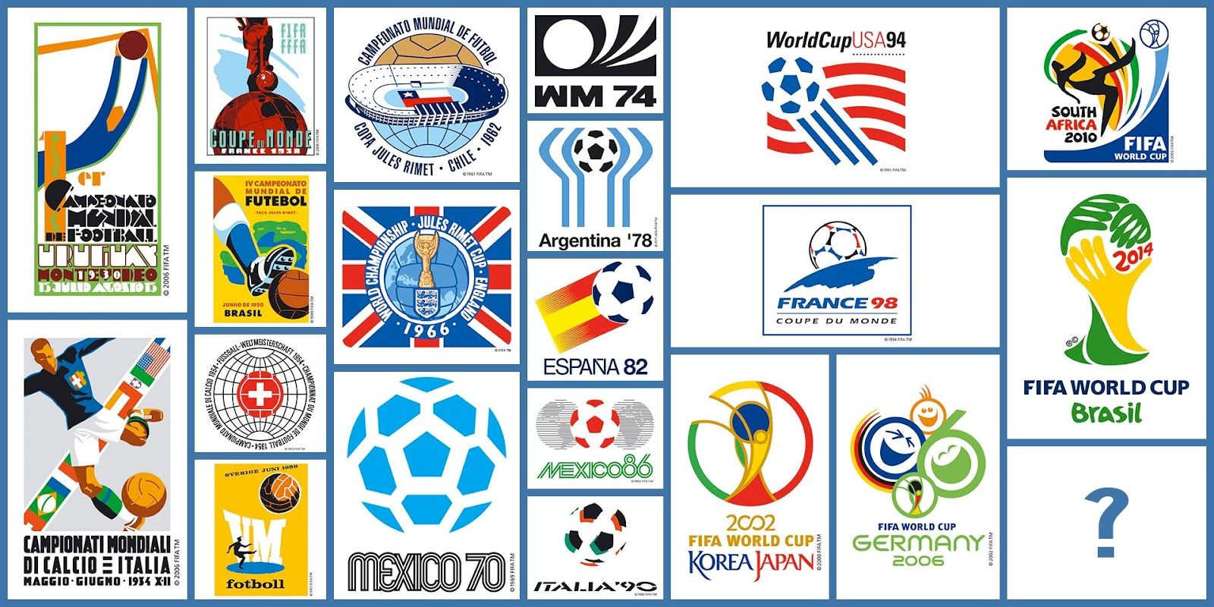
Kaggle Data
https://www.kaggle.com/abecklas/fifa-world-cup/home
Notes:
Match data is 850 observations of 21 variables after cleaning. World cup data is 21 observations of 17 variables. The Kaggle also includes player data, but it was not included on the project.

Slide 5
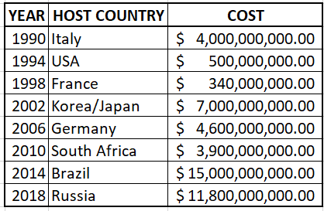
Known Economic Impacts
Hosting the event usually costs billions
Hosting countries must give over $200 Million in tax exemptions to FIFA
Zero-Sum impact of hosting at best, normally an overall net negative
No cost infor prior to 1990

Slide 6
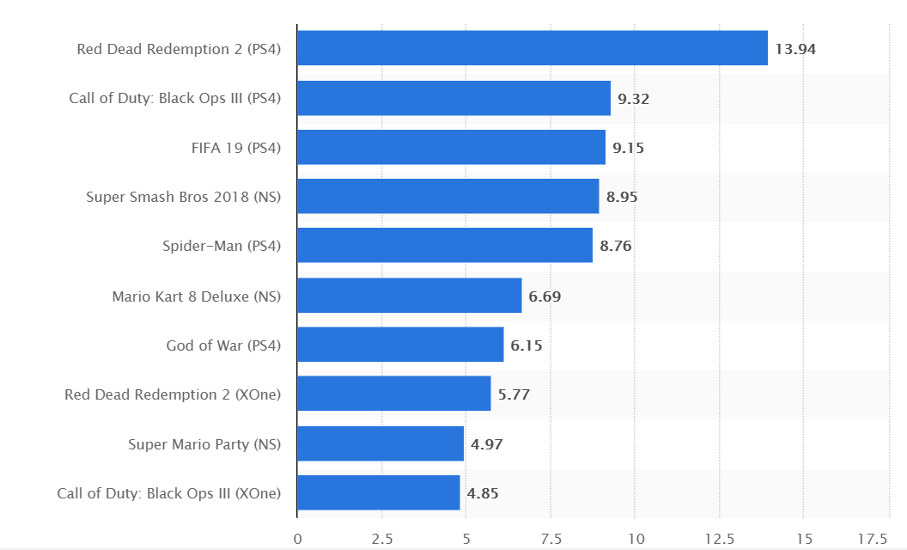
US Video Game Sales 2018 by Unit (Millions)
Source: www.statista.com/statistics/273335/sales-of-the-worlds-most-popular-console-games-in-2011/
Notes:
FIFA’s video game (frequently derided as the same game with each update) is the third best selling video game. Although host countries don’t make money, FIFA has multiple lines of revenue.

Slide 7
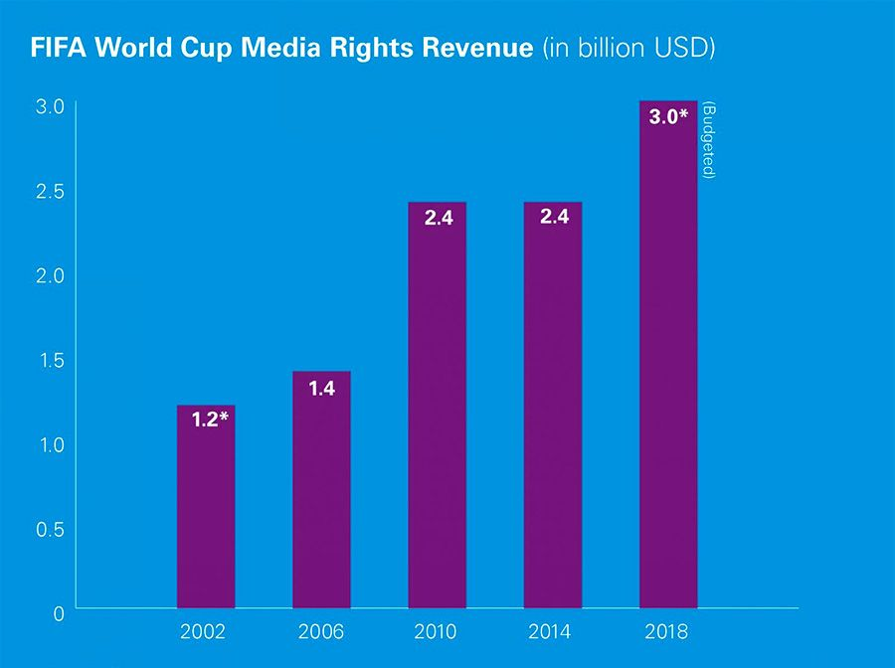
World Cup Media Revenue
Source: www.consultancy.uk/news/17637/broadcast-haul-of-fifa-world-cup-2018-in-russia-leaps-to-3-billion

Slide 8
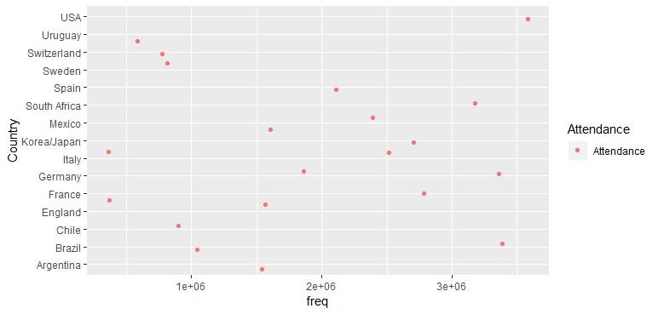
Attendance by Nation Since 1930

Slide 9
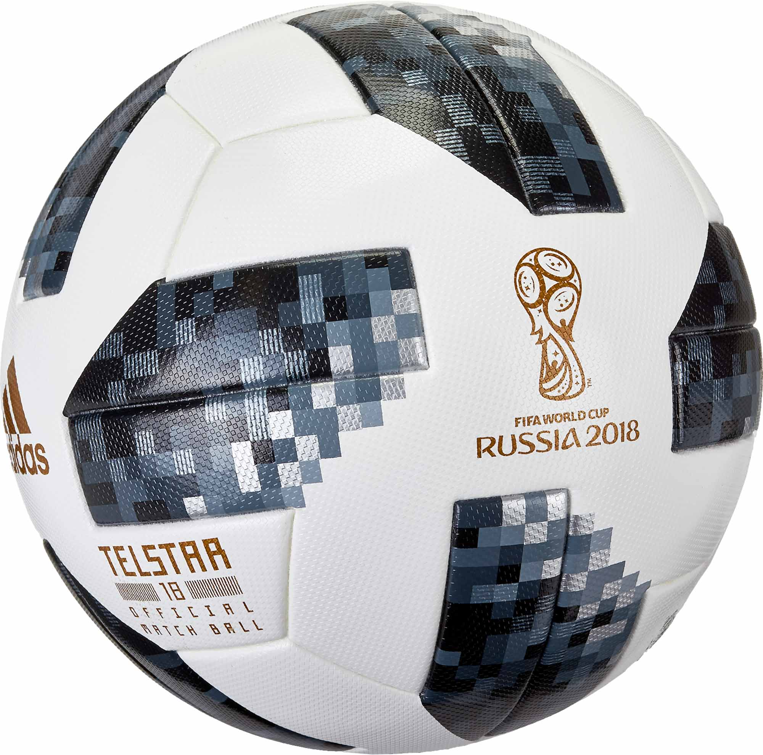
Project Goals
Goals:
Analyze the factors that equate to positive and negative impacts of hosting the World Cup
Analyze the impact of competing and winning the tournament
Should anyone want to host the world cup?

Slide 10
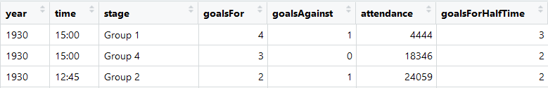
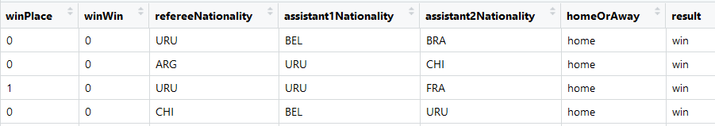
About the data
Two datasets, World Cup Data and World Cup Match specific data
World Cup Match Data

Slide 11
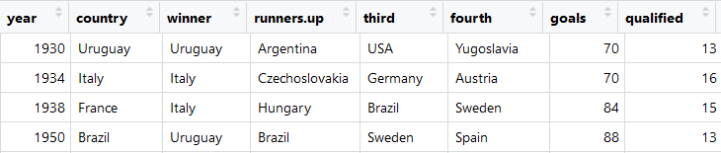
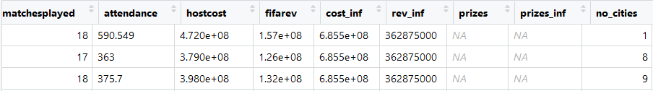
About the data
Two datasets, World Cup Data and World Cup Match specific data
World Cup Data
Notes:
What little financial data were available were added in Excel. Columns were also added to determine the winner of each match, and to add a binary determinant for whether teams placed in the tournament or won it. These were the labels for the ML models.

Slide 12
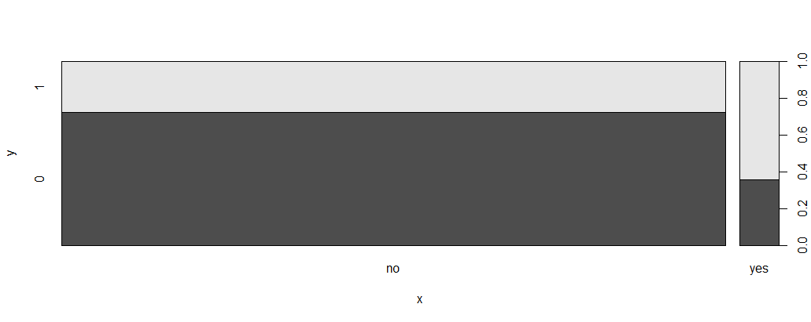
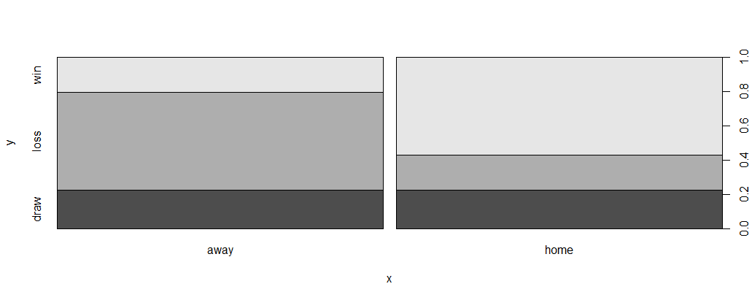
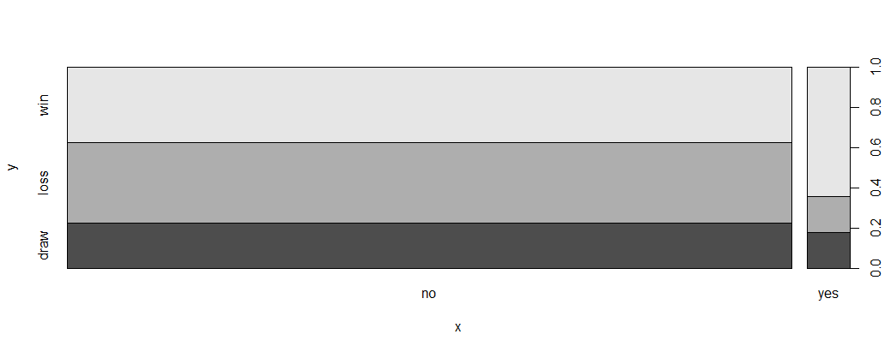
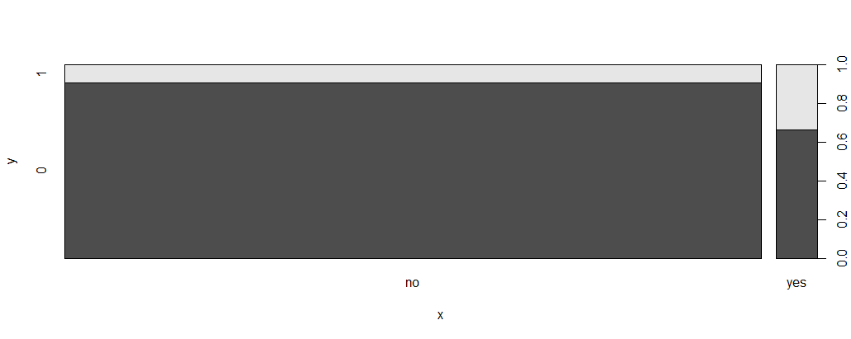
Analysis: Data Exploration- Matches
Likeliness to place if host, win game if home/away, win game if host, win tournament if host
Notes:
One feature that really stands out is that the home team wins most of the time.

Slide 13
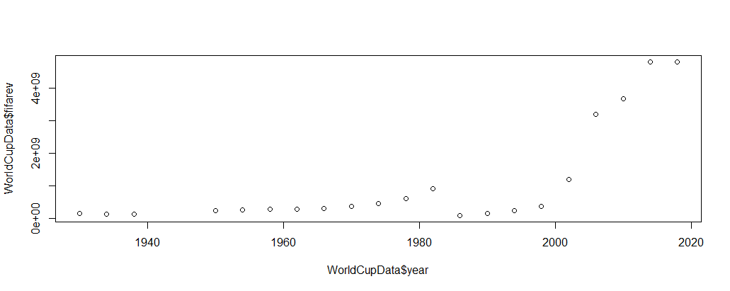
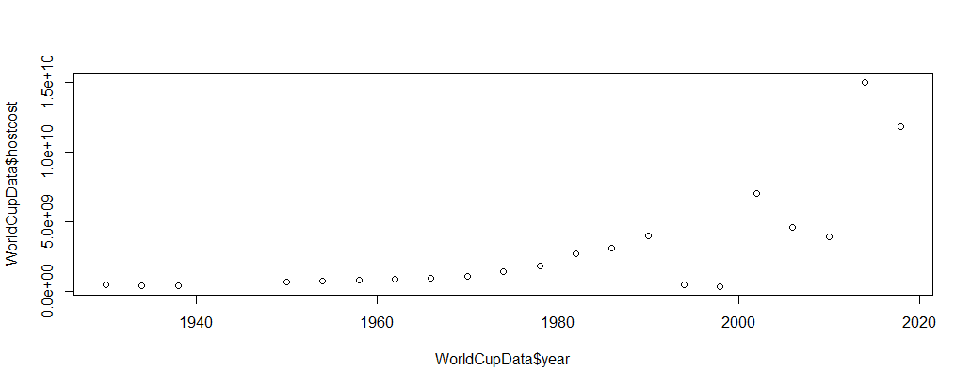
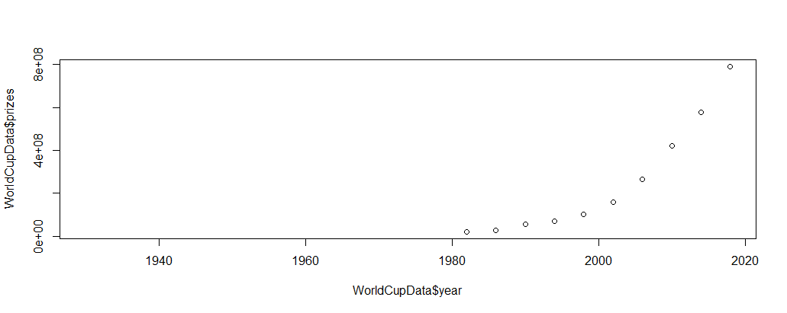
Analysis: Data Exploration- Financials
Notes:
There were no financial prizes prior to 1982, but the amount of prize money has gone up every year since then. It’s in the hundreds of millions now. The 2018 prize money totaled $400 million.

Slide 14
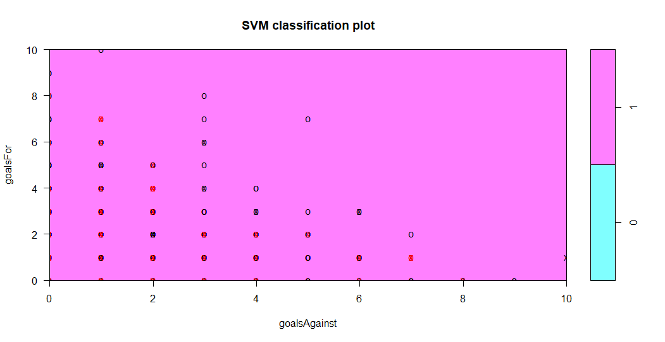
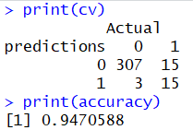
Analysis: Model Specific
Notes:
The SVM model was constructed in the same manner as the rest of the models, with the data split randomly into 80% training data and 20% testing data. Similar to the Random Forest, it predicted wins at around 95% accuracy. It predicted whether teams would place with an accuracy of around 80%.

Slide 15
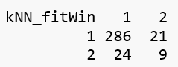
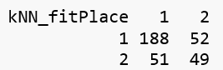
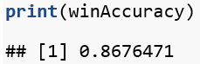
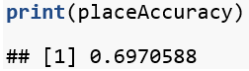
KNN
Notes:
KNN predicted wins with an accuracy of nearly 87%. This result came after transforming all the data in the data frame to numeric type. As previously stated, KNN is ideally used for domains like recommendation engines, search engines, and anomaly detection. It was not the best model for this analysis, and it seemed all the supervised models performed similarly, so this was not a surprise. KNN place prediction accuracy came in at over 69%. As with the other models, an 80/20 train/test split was employed to arrive at this result.

Slide 16
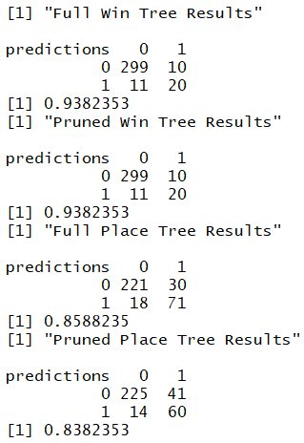
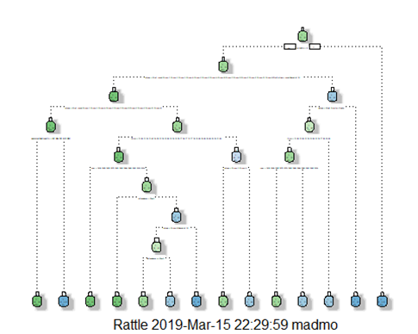
Decision Trees
Notes:
While pruning did not improve the tournament win prediction, it was effective in improving tournament place prediction. Predicting wins will always have high percentages since there have only ever been 8 winning national teams. This is likely why the pruning did not help the win prediction. Data on World Cup wins is limited. The limits are not a result of the unavailability of data, but the small number of World Cup tournaments (21). Pruning did increase the prediction of whether teams would place in the top 4 to over 85%.

Slide 17
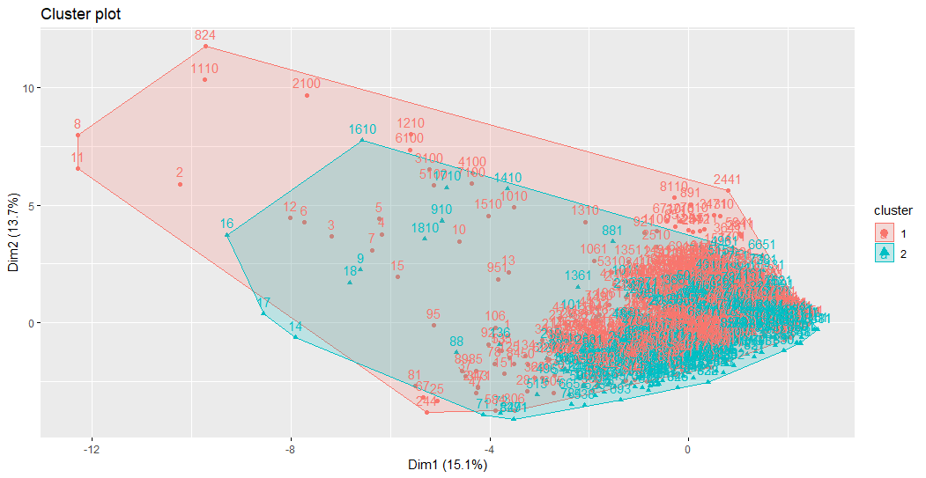
Analysis: Model Specific
K-Means

Slide 18
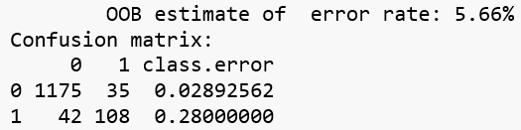
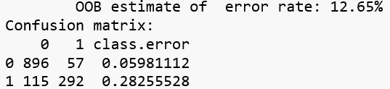
Random Forest
Win prediction
Place prediction
Notes:
For the Random Forest model, data was split 80% for training and 20% for testing using a random sample method. 500 trees were built for each prediction model, and a classification model was used. The win prediction performed as expected, with a 5.66% error rate. Again, this is a small set of data, so the results must be considered from that perspective. When these models were tested against the known results in the test data, they returned the best results thus far, with a win prediction accuracy of more than 95%, and a place prediction accuracy of 87.6%. These results came from an analysis of 340 predictions.

Slide 19
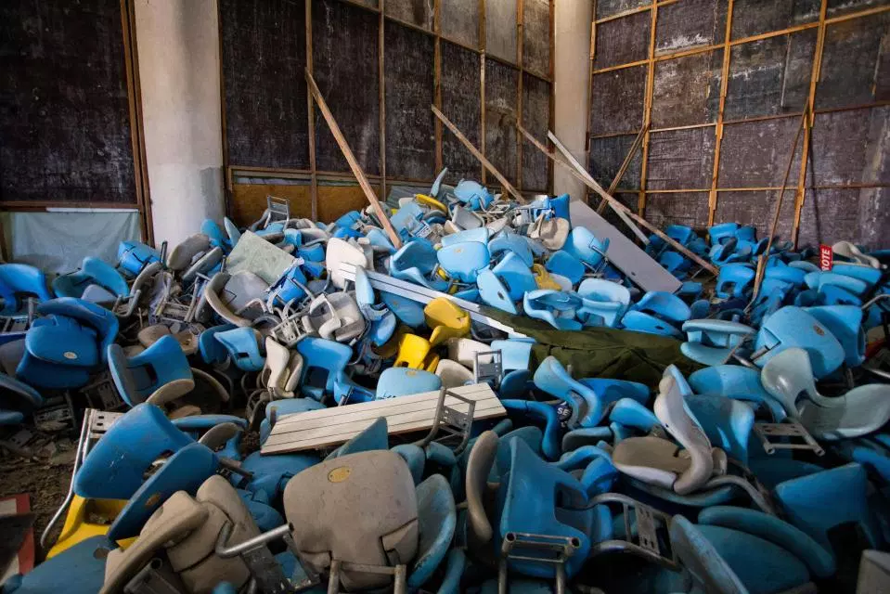
Goals Met?
Ultimately, our data wasn’t enough to predict financial gains
Couldn’t find reliable viewership and tourism numbers
Possible financials are not available because they are negative
Ascertained that it is never a positive financially to host
Winners are only countries that have less negative impact

Slide 20
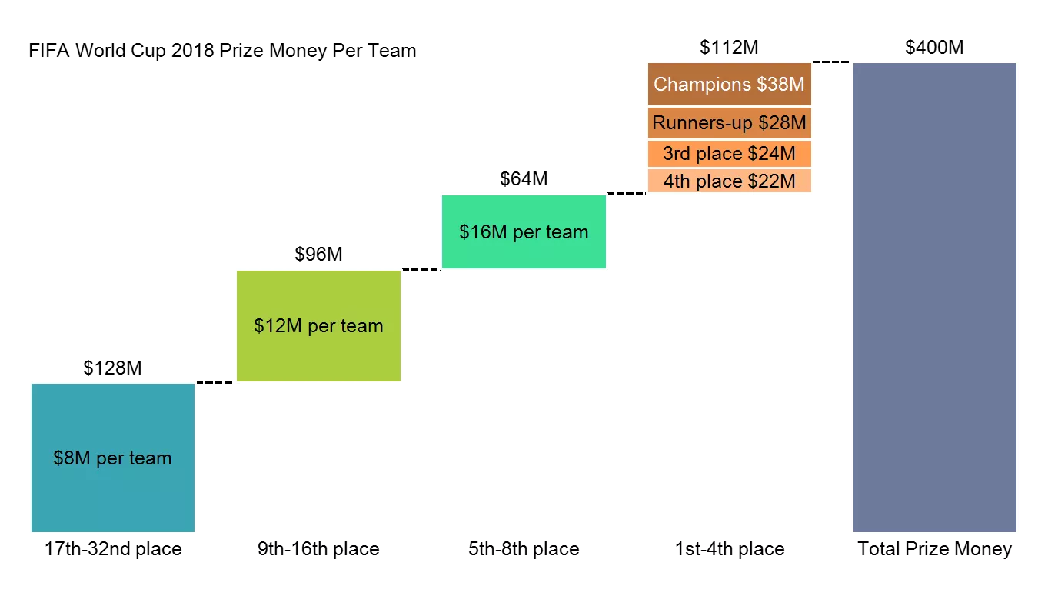
National team benefit is prize money
While host countries are picking up the tab, national teams are making lots of money by winning or placing in the top 4
Notes:
The real benefits go to FIFA and the national teams that participate, as long as they are not also the host country.

Slide 21
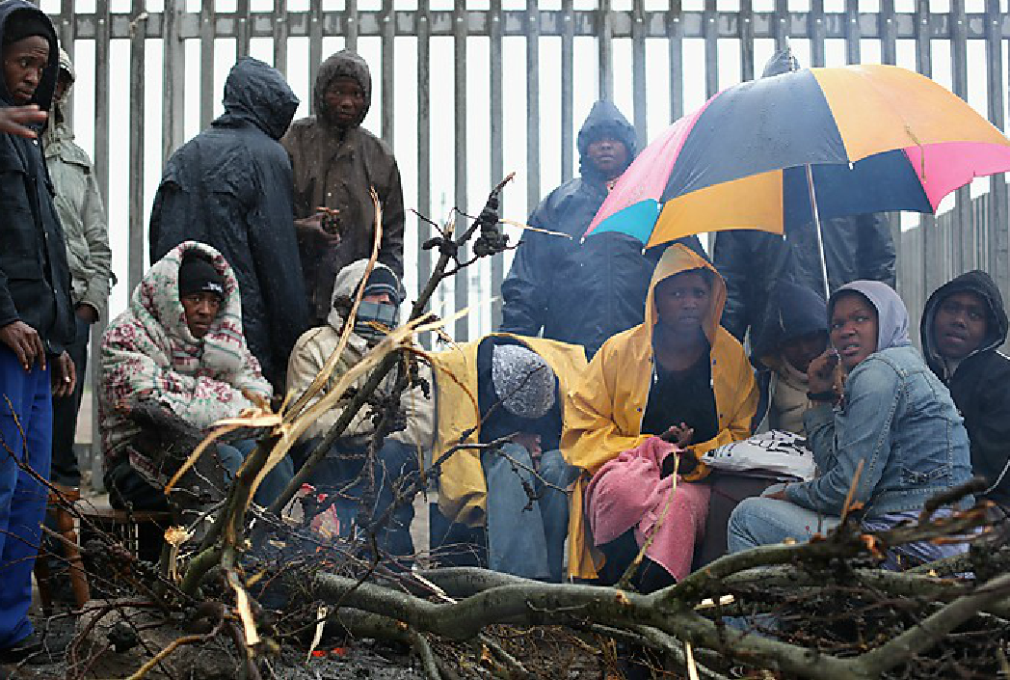
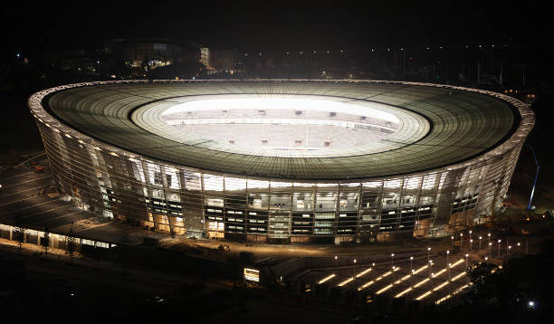
Neighborhoods near Cape Town relocated to build stadium
Notes:
Cape Town Stadium is now available for private functions, birthday parties, weddings, and anniversaries, according to the Globe and Mail. It cost $536 million to build and required shanty town residents to be displaced.

Slide 22
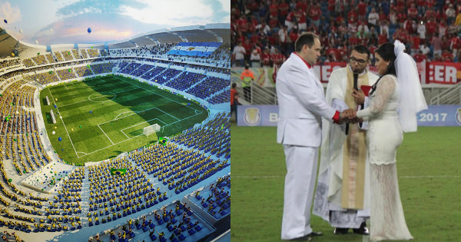
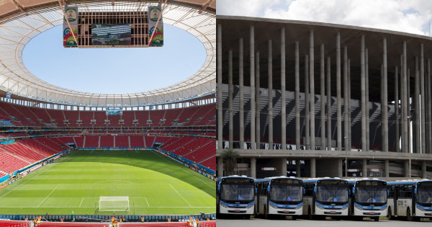
Brazil’s Unused Stadiums
Notes:
Arena das Nutas in Brazil is also hosting weddings and other private events. Arena da Amazônia has been sold to a private owner after losing money consistently once the World Cup ended. Estadio Nacional de Brasília Mané Garrincha is now being used as a bus parking lot. Combined, the stadiums cost around $1.5 Billion to construct.

Slide 23
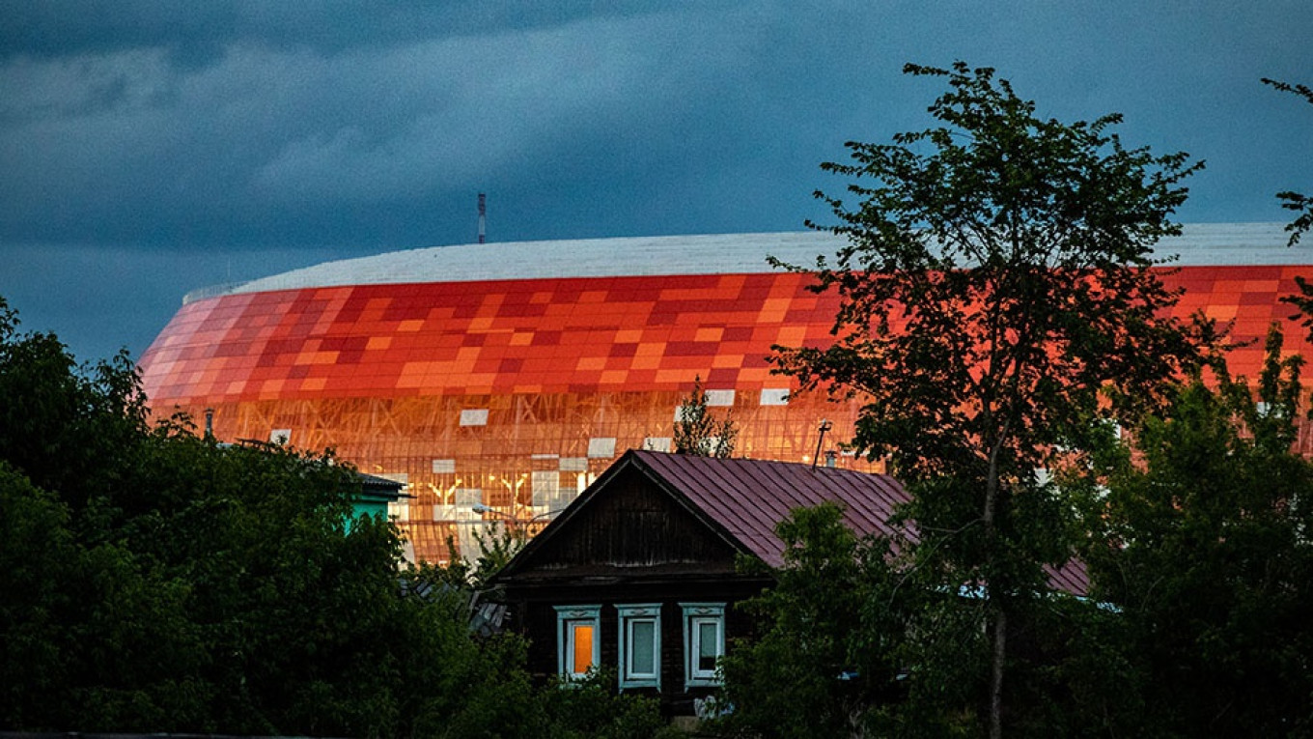
Financial woes in Russia
Notes:
Russia spent an estimated $3.4 billion on constructing nine new stadiums from scratch and renovating three others, in addition to building 96 training grounds, which will reportedly be passed on to youth teams after the tournament, according to FIFA. So far, ticket sales have not been sufficient to cover costs, according to The Moscow Times.

Slide 24
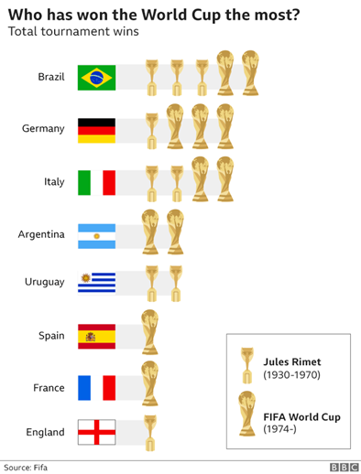
Only 8 teams have ever won the World Cup.
This is only around 10% of the 79 national teams that have played in the tournament.
Notes:
Teams should focus on winning, but predicting the winner is too easy for complex machine learning algorithms, so the results aren’t very good.

Slide 25
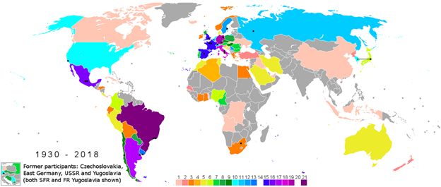
Because so few countries have participated in the World Cup, data is limited.
Notes:
While there are many potential observations available, predicting wins depends on tiny portions of the data. Predicting whether teams will place works better because there are more observations.

Slide 26
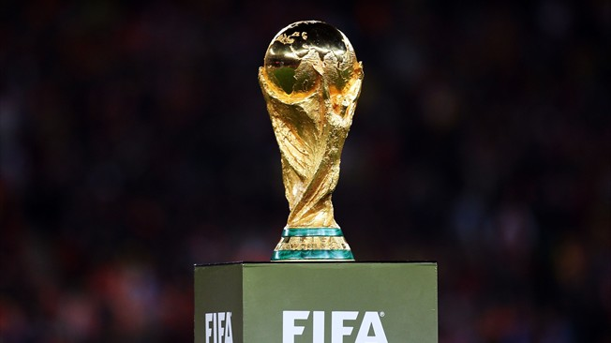
Conclusion and Further Research
Ultimately, hosting the World Cup does not seem to create financial gain
Only winners of the tournament come close to gaining financially because prize money is significant and host countries foot the bill for travel and hospitality
National teams should focus on winning the tournament, but using ML to predict their chances is questionable
Data sources (Fifa, Air Traffic, Country GDP, Tourism)

